Slide 1

ONLINE MOVIE TICKET BOOKING

Slide 2
TEAM MEMBERS:
Brindhaa Balasubramaniam - 2563506
Muthupriya Murugesan - 2563143
Navya K K - 2563265
Nikita Dhananjay Gaikwad - 2563147
Ponugoti Sireesha Reddy - 2563594
Sandesh A Ram - 2563963
Sarthak Srivastava - 2563478
Sriharinivaishnavi S - 2562976
Archana Murugesan - 2562954

Slide 3
CONTENTS
Abstract
Tools & Technologies
Microservices
Benefits of Microservices
Microservices Architecture
Database Schema
Postman Testing
Admin & User functionalities
Advantages
Futurescope
Conclusion

Slide 4
ABSTRACT
This abstract outlines the design and architecture of a modern movie ticket booking system utilizing microservices.
The movie ticket booking system is a critical component of the entertainment industry, allowing users to browse, select, and purchase movie tickets. Leveraging microservices architecture, this system achieves greater flexibility and adaptability to meet evolving user demands.
We have used spring-boot for the backend and MySQL for the database and POSTMAN for testing.
Each microservices is responsible for a specific task, such as User, Theatre, Movie, Booking, Payment, Language and Genre.

Slide 5
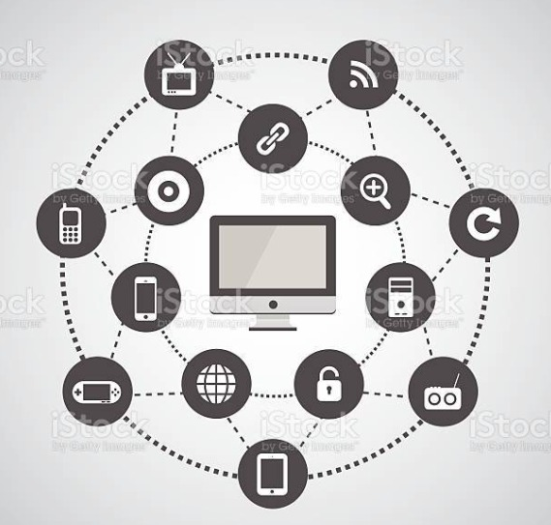
TOOLS AND TECHNOLOGIES
Java microservices Architecture
Spring Boot, Spring Cloud, Spring Data JPA
MySQL
EmbededTomcat
Git Hub
Spring Cloud Config, Spring Cloud Netflix Eureka, Feign, Resilience4j, Retry, Sleuth and Zipkin.

Slide 6
MICROSERVICES
Java microservices refer to a software architecture approach in which an application is built as a collection of small, independent, and loosely coupled services, all written in Java.
Each microservices is responsible for a specific business capability or function and communicates with others over a network, often using lightweight protocols like HTTP or messaging systems.
Java microservices architecture is an approach to software development that emphasizes small, independently deployable services that communicate to provide a complete application.

Slide 7
BENEFITS OF MICROSERVICES
Some of the benefits of using Java microservices include:
Scalability
Agility
Resilience
Maintainability

Slide 8
MICROSERVICES ARCHITECTURES
Config Server
Eureka
Feign
Resilience4j and Retry
Sleuth and Zipkin

Slide 9
CONFIG SERVER
A config server is a centralized repository for storing configuration data for microservices. This data can include things like database connection strings, API keys, and environment variables.
A "Config microservice" typically refers to a microservice or component within a microservices architecture that is responsible for managing and distributing configuration settings and parameters to other microservices and applications in the system.
The config servers also store Authentication configuration information such as Role-Based Access Control or internal authentication settings for the cluster.

Slide 10
EUREKA
Netflix Eureka is a Java-based open source project that provides a RESTful interface for service discovery and registration.
Eureka helps to make microservices more resilient by providing a central registry of microservices. This means that if one microservice goes down, the other microservices can still find each other.
Eureka Server integrates with load balancing mechanisms such as Ribbon. This means that clients can query Eureka Server to retrieve a list of available service instances for a specific service.

Slide 11
FEIGN
The Feign client is a declarative REST client that makes writing web clients easier. When using Feign, the developer has only to define the interfaces and annotate them accordingly.
Microservices use Feign clients to interact with other microservices' APIs or endpoints, making it easier to implement inter-service communication.
The @FeignClient annotation is a part of the Spring Cloud Netflix project and is used in Spring-based applications to simplify the process of making HTTP requests to other RESTful services, often within a microservices architecture.

Slide 12
RESILIENCE4J
Resilience4j is a lightweight fault tolerance library that provides a variety of fault tolerance and stability patterns to a web application.
Resilience4j provides higher-order functions (decorators) to enhance any functional interface, lambda expression or method reference with a Circuit Breaker, Rate Limiter, Retry or Bulkhead.
With Resilience4j you don't have to go all-in, you can pick what you need.
Resilience4j provides several core modules and add-on modules

Slide 13
RETRY
Automated Retry: Resilience4j's Retry module automates retries for handling transient failures in microservices.
Declarative or Programmatic: Retry behavior can be configured declaratively with annotations or programmatically in code.
Exponential Backoff: It supports strategies like exponential backoff to reduce the load on failing services.
Customizable Control: Highly customizable with options for defining retry count, intervals, and conditions for precise control over retry logic in microservices.

Slide 14
SLEUTH & ZIPKIN
Sleuth is a library that helps to generate and propagate trace IDs across multiple services. Trace IDs are unique identifiers that can be used to correlate requests across multiple services.
Zipkin is a server that collects and stores trace data. It can be used to visualize and analyze trace data, helping you to identify performance bottlenecks and other problems in your microservices architecture.
Together, they offer a comprehensive solution for understanding and optimizing microservices-based applications.

Slide 15
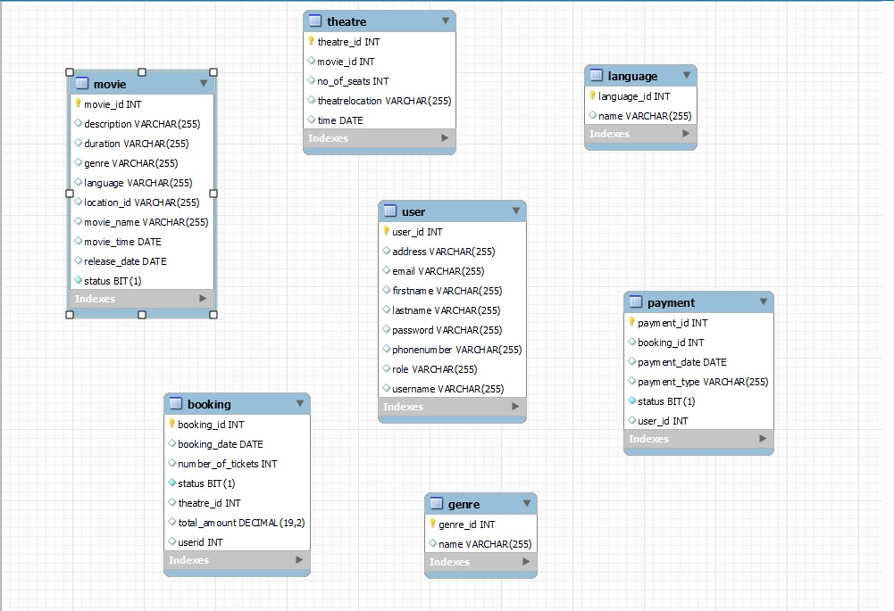
DATABASE SCHEMA

Slide 16
POSTMAN TESTING
Postman is an application used for API testing. It is an HTTP client that tests HTTP requests, utilizing a graphical user interface, through which we obtain different types of responses that need to be subsequently validated.
It is a tool for testing the software of an API. It can be used to design, document, verify, create, and change APIs. Postman has the feature of sending and observing the Hypertext Transfer Protocol (HTTP) requests and responses

Slide 17
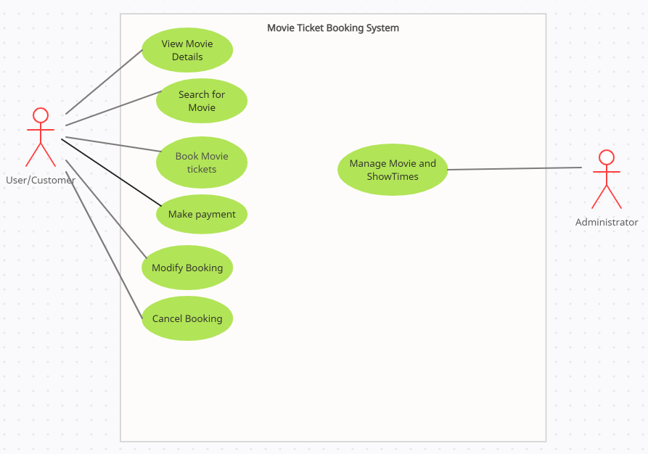
ADMIN & USER FUNCTIONALITIES

Slide 18
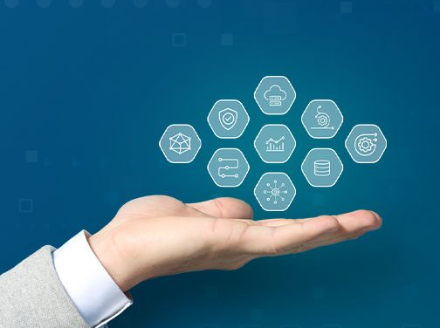
ADVANTAGES
TIME SAVING
USER FRIENDLY
COMPATIBLE WITH ALL DEVICES
USER CAN GET DESIRED SEATS
MULTIPLE OPTIONS AVAILABLE ON ONE CLICK

Slide 19
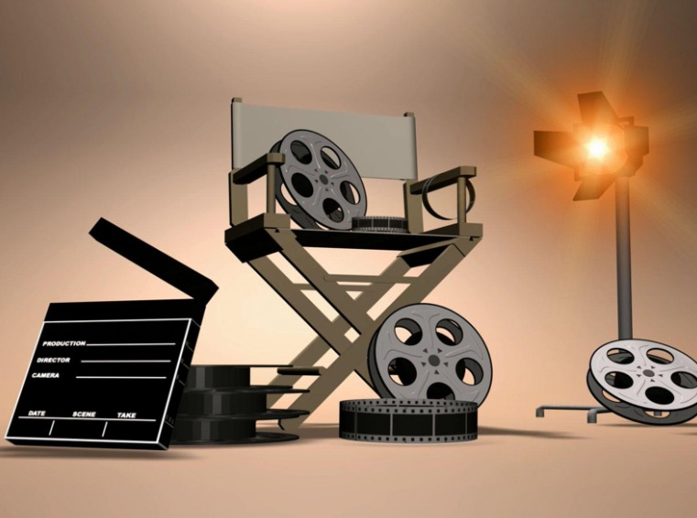
FUTURE SCOPE
Provide a list of upcoming movies.
Allow users to comment on movies.
SMS notification after successful seat reservation.
Encrypted webpage to ensure users privacy
and transaction security.
More user friendly interface also in small screen devices.

Slide 20
CONCLUSION
This project has been developed successfully and the performance of the system has been found satisfactory.
Use of this interface helps customer in having immediate information about running movies and reserve their seat without wasting their precious time.
User friendly Interface also for the admin to add and delete movie information.

Slide 21


